Slide 1

Planning And Estimation
Arunraj R.
Business Analyst

Slide 2
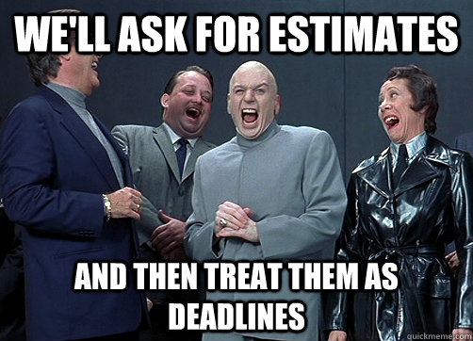
Importance of Estimation?

Slide 3
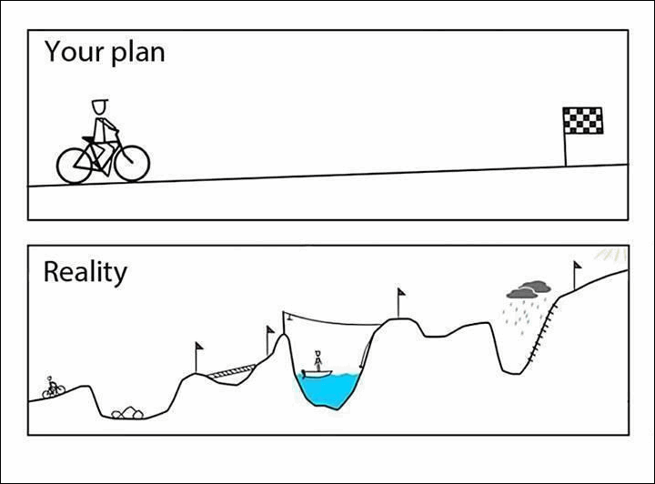
Importance of Estimation?

Slide 4
Importance of Estimation?

Slide 5
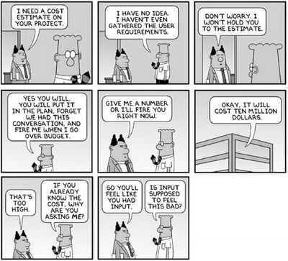
Traditional Estimation Approach

Slide 6
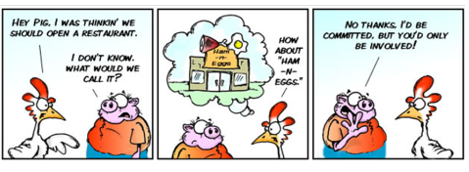
How is it different in Scrum?

Slide 7
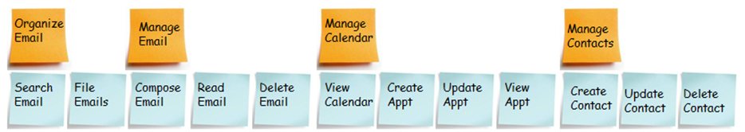

Where do we begin?
Email Management System ☺
Theme
Epics (features)
Create and send basic email
Open & read basic email
Open RTF email
Send RTF email
Delete email
Import & process contacts
Search by keyword
Create sub folders
Move emails
Send HTML email
Create HTML email
User Stories

Slide 8
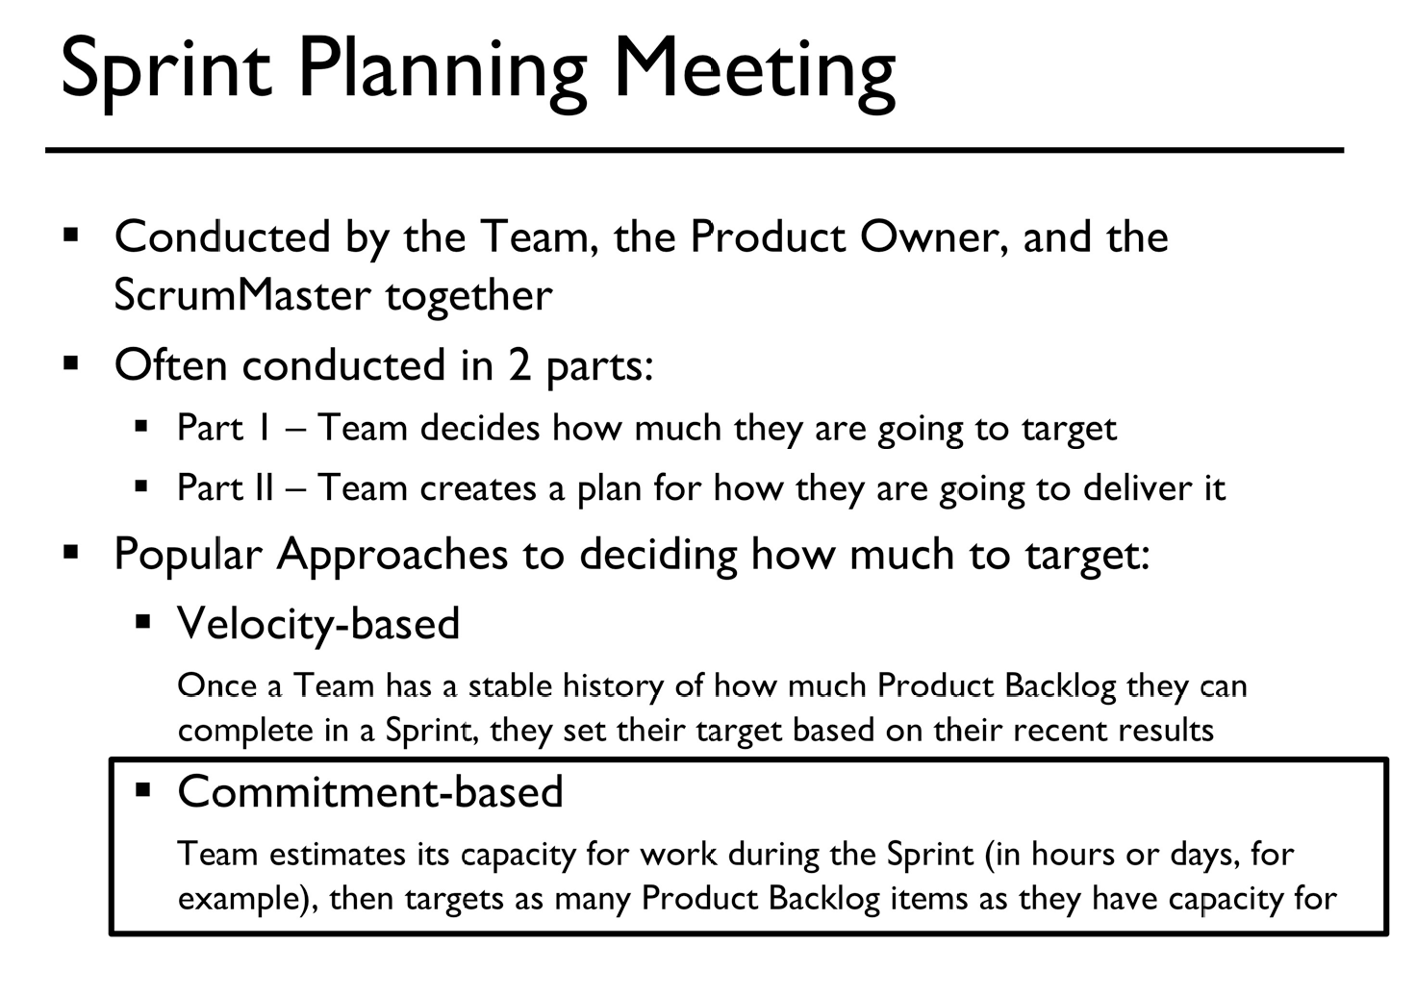

Slide 9
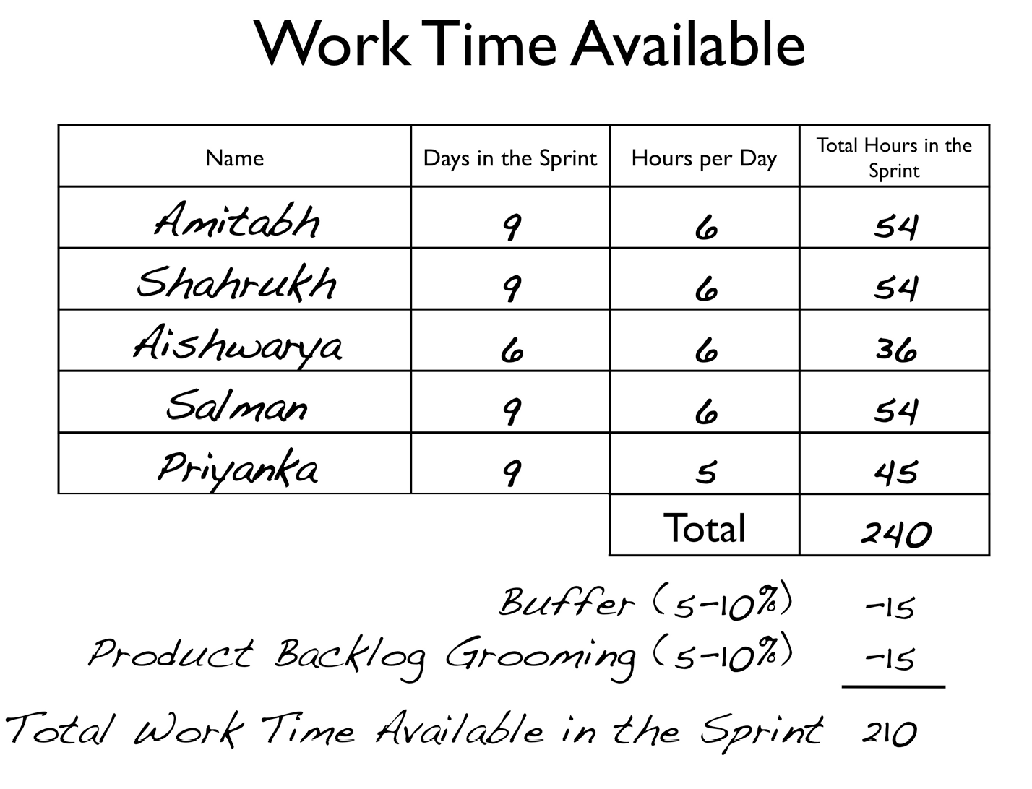

Slide 10
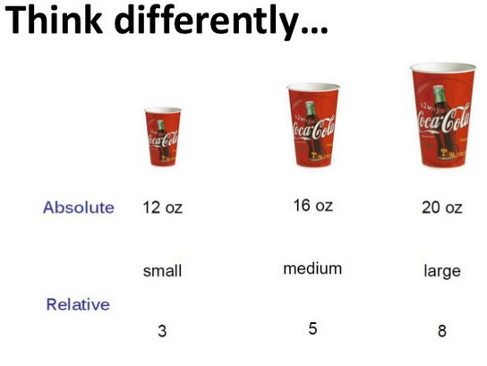
Velocity Based – Story Points!

Slide 11
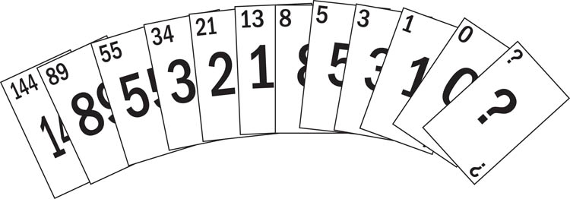
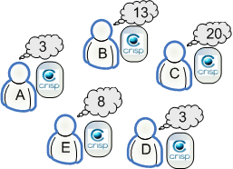
Planning Poker

Slide 12
Best Practices
Split tasks into smaller.
Track your working time.
Keep in mind each stage (testing, code review, and etc.).
Each Team has own velocity
Let whole Team estimate.
Estimation also takes time.
Definition of Done.
Use best practices like planningpoker.com.

Slide 13

ANY
QUESTIONS/FEEDBACKS ?

Slide 14


** All images shamelessly stolen from GOOGLE.

